Slide 1
PSAT MINI PROJECT
Done By: Rohit S Nair

Slide 2
Question
Write a program that helps to allocate seats in a theatre while online booking. Considerthere are 10 rows and each row has 10 seats. So total there will be 100 seats. While booking always you should make sure the continuous seat allotment whenever it is possible. Seat allocation can start from the first row. Suppose if the continuous seat allotment is not possible then the user can be informed and if the user agrees, then the seats can be allocated. When all the allocation finishes, display the number of empty seats.

Slide 3

Tool Used
Flowgorithm

Slide 4
Methods Used
1.Loops(For Loop and While Loop)
2.Arrays(String Array and Integer Array)
3.Conditional Statements
4.ToChar
5.Breakpoint

Slide 5
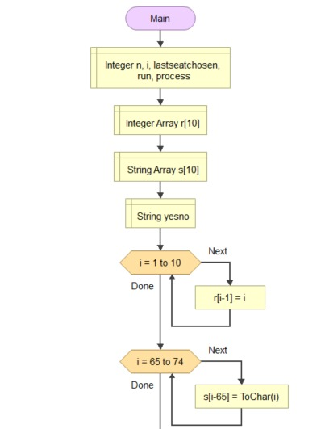

Slide 6
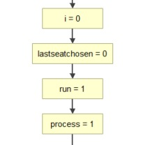

Slide 7
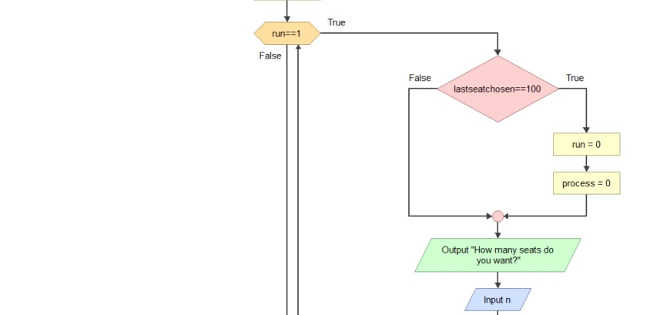

Slide 8
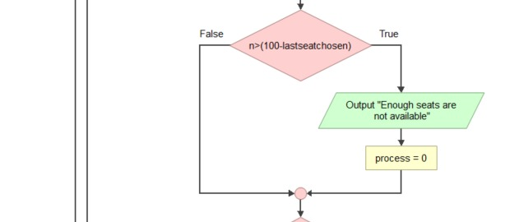

Slide 9
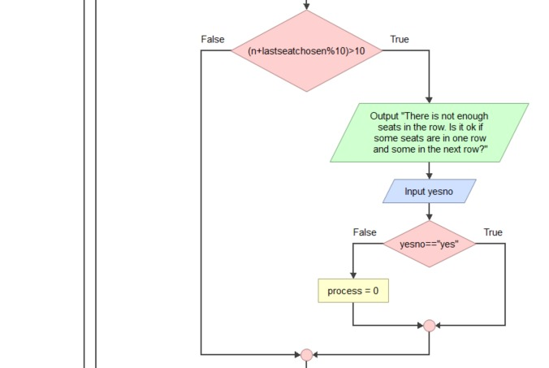

Slide 10
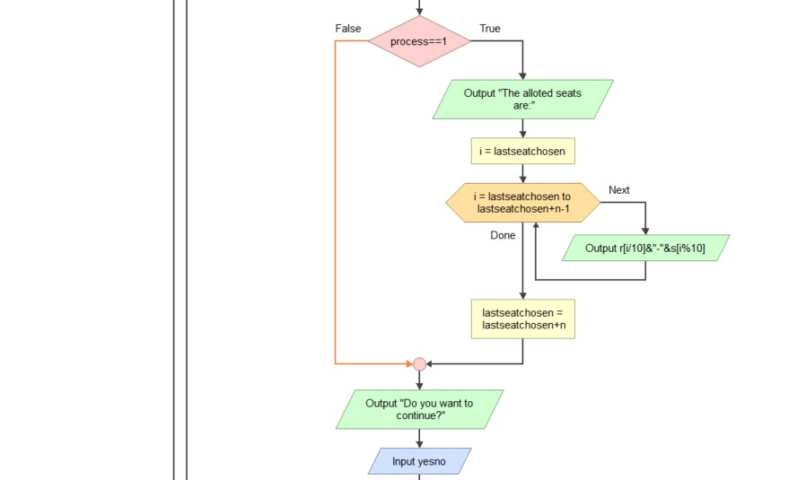

Slide 11
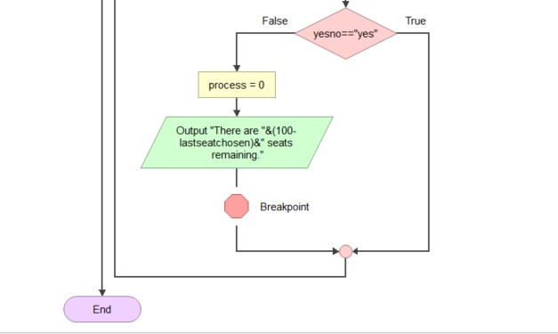

Slide 12
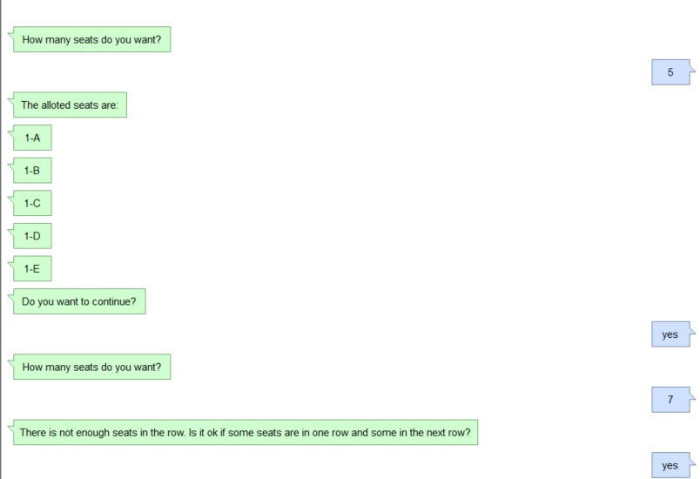
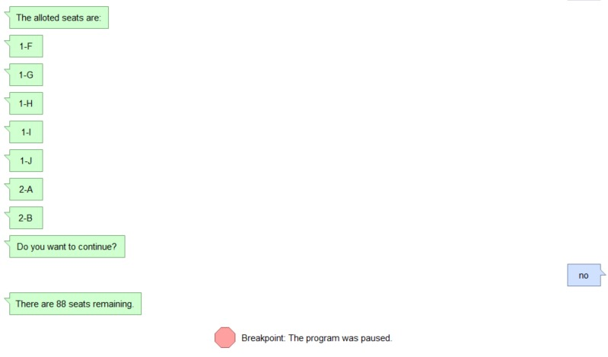
OUTPUT

Slide 13
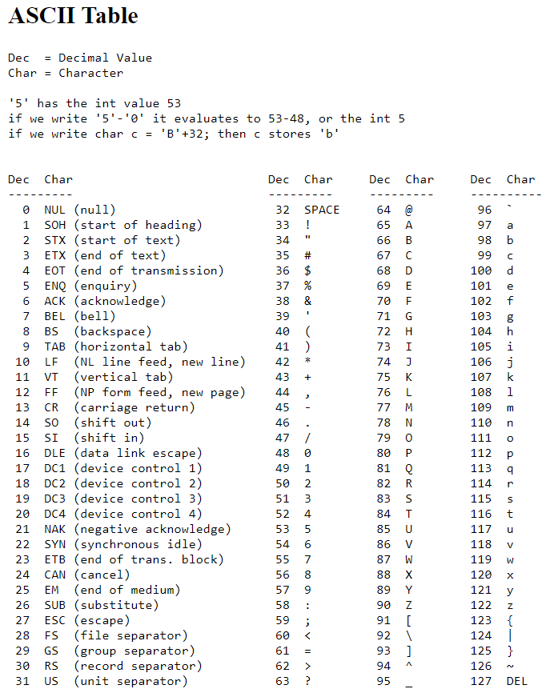
ASCII Table

Slide 14


